Slide 1

Database Management Systems
Shamim Ahmad

Slide 2
Introduction
Purpose of Database Systems
View of Data
Data Models
Data Definition Language
Data Manipulation Language

Slide 3
Data vs. Information
Data:
Raw facts; building blocks of information
Unprocessed information
Information:
Data processed to reveal meaning
Accurate, relevant, and timely information is key for good decision making
Good decision making is the key for survival in a global environment

Slide 4
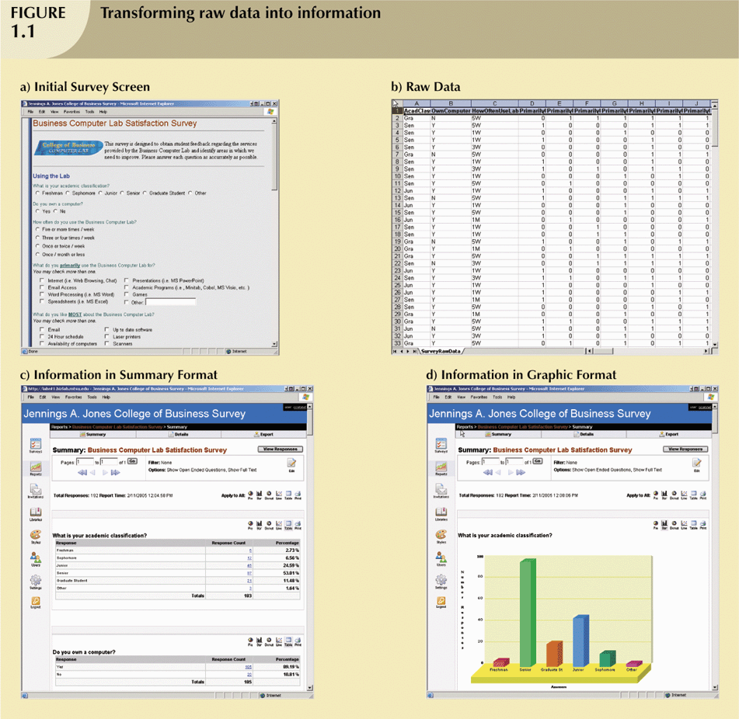
Transforming Raw Data into Information

Slide 5
Transforming Raw Data into Information (continued)

Slide 6
Transforming Raw Data into Information (continued)

Slide 7
Transforming Raw Data into Information (continued)

Slide 8
Introducing the Database and the DBMS
Database—shared, integrated computer structure that stores:
End user data (raw facts)
Metadata (data about data)

Slide 9
Introducing the Database and the DBMS (continued)
DBMS (database management system):
Collection of programs that manages database structure and controls access to data
Possible to share data among multiple applications or users
Makes data management more efficient and effective

Slide 10
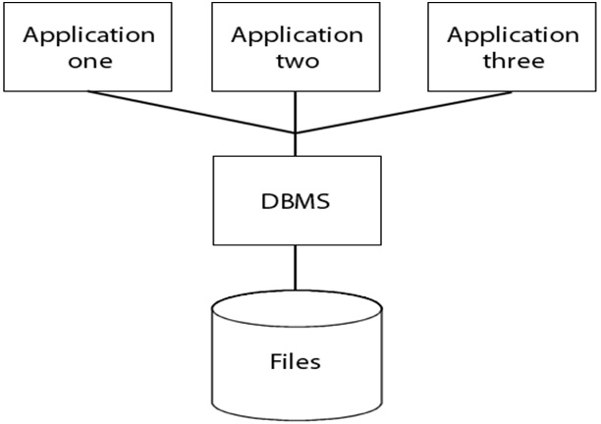
Role and Advantages of the DBMS (continued)

Slide 11
Database Management System (DBMS)
Database Applications:
Banking: all transactions
Airlines: reservations, schedules
Universities: registration, grades
Sales: customers, products, purchases
Manufacturing: production, inventory, orders, supply chain
Human resources: employee records, salaries, tax deductions
Databases touch all aspects of our lives

Slide 12
Role and Advantages of the DBMS (continued)
End users have better access to more and better-managed data
Promotes integrated view of organization’s operations
Probability of data inconsistency is greatly reduced
Possible to produce quick answers to ad hoc queries

Slide 13
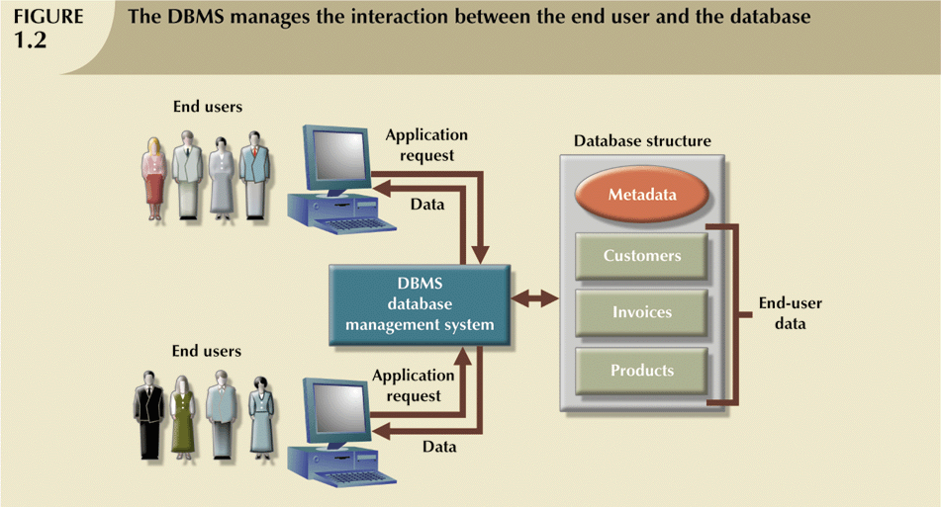
Role and Advantages of the DBMS (continued)

Slide 14
Types of Databases
Single-user:
Supports only one user at a time
Desktop:
Single-user database running on a personal computer
Multi-user:
Supports multiple users at the same time

Slide 15
Types of Databases (continued)
Workgroup:
Multi-user database that supports a small group of users or a single department
Enterprise:
Multi-user database that supports a large group of users or an entire organization

Slide 16
Types of Databases (continued)
Can be classified by location:
Centralized:
Supports data located at a single site
Distributed:
Supports data distributed across several sites

Slide 17
Types of Databases (continued)
Can be classified by use:
Transactional (or production):
Supports a company’s day-to-day operations
Data warehouse:
Stores data used to generate information required to make tactical or strategic decisions
Often used to store historical data
Structure is quite different

Slide 18
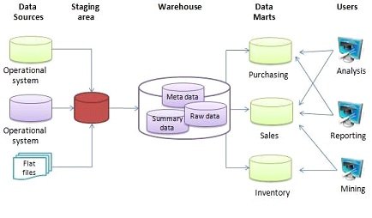
The basic architecture of a data warehouse
Extract, transform, load (ETL)
Extract, load, transform (E-LT)

Slide 19

Purpose of Database System
Office Records ort File Systems

Slide 20
Why Database Design is Important
Defines the database’s expected use
Different approach needed for different types of databases
Avoid redundant data
Poorly designed database generates errors → leads to bad decisions → can lead to failure of organization

Slide 21
Purpose of Database System
In the early days, database applications were built on top of file systems

